Slide 1
Practice Lab:
This Practice Lab is dependent on Discussion Unit 6254, where most of the objects we create in this lab were introduced.
In this Practice Lab, we create a table, add data, snapshot, delete the table's contents, then restore.
DSE Core Backup and Recovery
Notes:
The goal of this Practice Lab is to use snapshots to restore data.

Slide 2

Challenge 1: Backup, then Restore
Prerequisites:
Instructions are provided for a single node DSE Core cluster.
There are additional steps for a multi-node cluster, that we overviewed in the Discussion Unit.
Instructions are provided for the command prompt using CQLSH, nodetool, other.
All work done as ‘root’
Notes:
To complete this Practice Lab, the following is assumed:
All prerequisites and conditions as listed above.

Slide 3
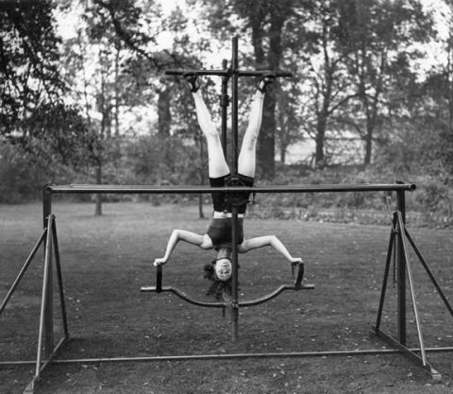
Challenge 1: Backup, then Restore
Using instructions from Discussion Unit 6254, complete the following:
Make a keyspace and table, add data
Snapshot the above
Truncate said table
Check for data
Copy the data files back to the proper location
nodetool refresh
Check for data
nodetool clearsnapshot --all
Notes:
Completer each of the steps listed above.
Use Discussion Unit 6254 for reference.

Slide 4

Practice Lab:
Lessons Learned
Notes:
Discuss what worked well, poorly, from the Practice Lab.

Slide 5
Notes:
End of Practice Lab-

